Slide 1
Year 10
Creating web pages using HTML, CSS and JS

Slide 2
Series of Six Lessons
Part 1
HTML Basics
Part 2
Adding Dynamic Styling (CSS)
Part 3
Introducing Javascript (JS)
Part 4
Dynamic Page Content
Part 5
Adding User Interaction
Part 6
Finish Up,
Write Up

Slide 3
Today’s Lesson Objectives - HTML Basics
You will learn about:
How to correctly create web pages using HTML
How to start formatting your content with CSS

Slide 4
Introduction
Design of web pages plays an important role
Well-designed pages often attract more visitors
It must be easy to use, quick to download, and to user requests
A web page should be accessible by all

Slide 5
What is HTML?
HTML is the standard markup language for creating web pages
HTML structures and presents content using tags and attributes
Tags start with <tagname> and (usually) end with </tagname>
Attributes are inline <tagname attribute=””>
Pages are separated into two components: <head> and <body>

Slide 6
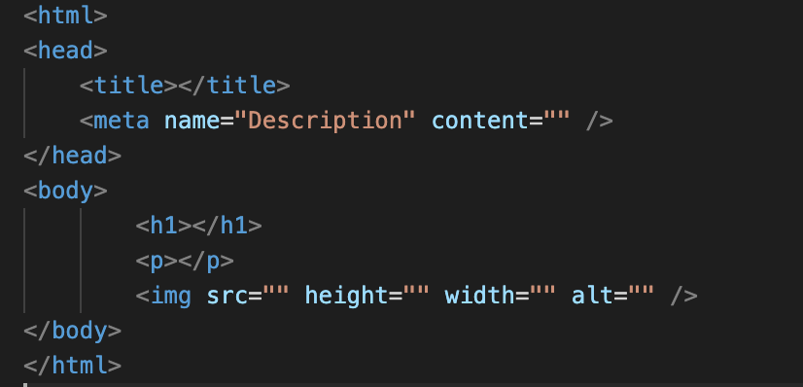
Important HTML tags

Slide 7
Important HTML tags
<html> | Opening tag of the document.
<head> | The container for metadata - data about data. Not visible, machine parsable.
<title> | Text that appears on the tab or window heading area, used in SERP. Only 1 per page.
<meta /> | Defines metadata about an HTML document e.g. Author, Description, Date Created, etc.
<body> | The container for visible page content.
<h1> <h2> <h3> | Headings in decreasing importance & size.
<p> | Paragraphs of text.
<img /> | Embedded images, photos, illustrations, etc.

Slide 8
Activity 1
10 minutes
Create a web page with the following:
Title
Description
Heading
Introductory paragraph(s)
Photograph of the school You can download school.jpg from Teams
Insert your HTML code into Microsoft Teams

Slide 9
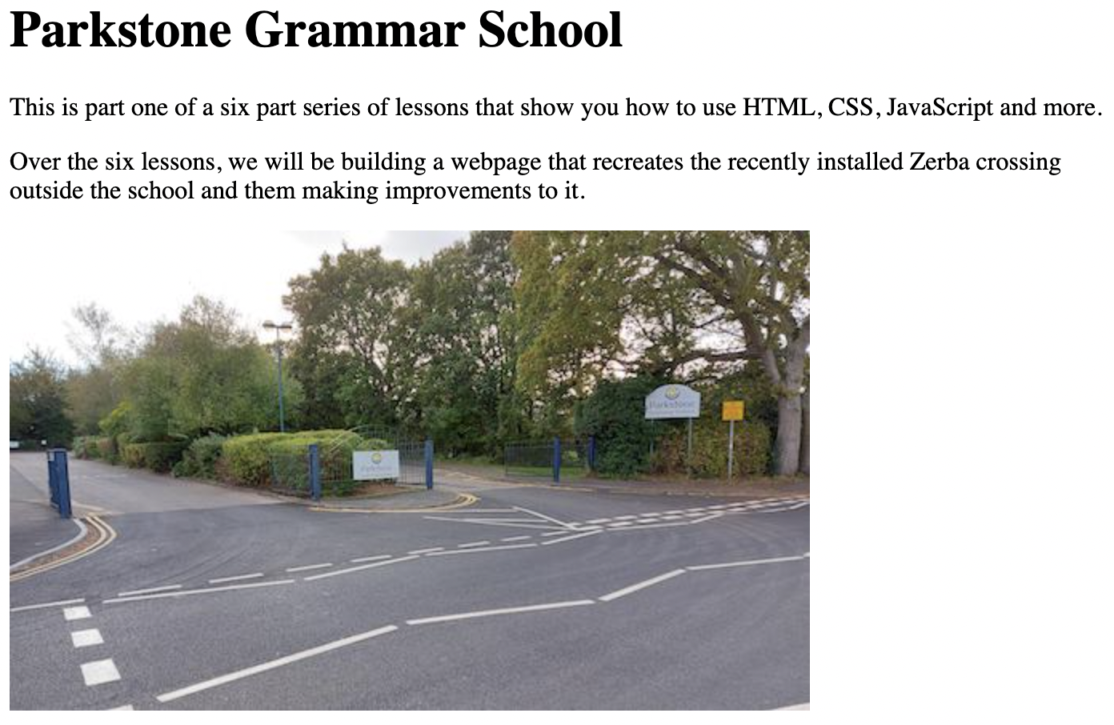
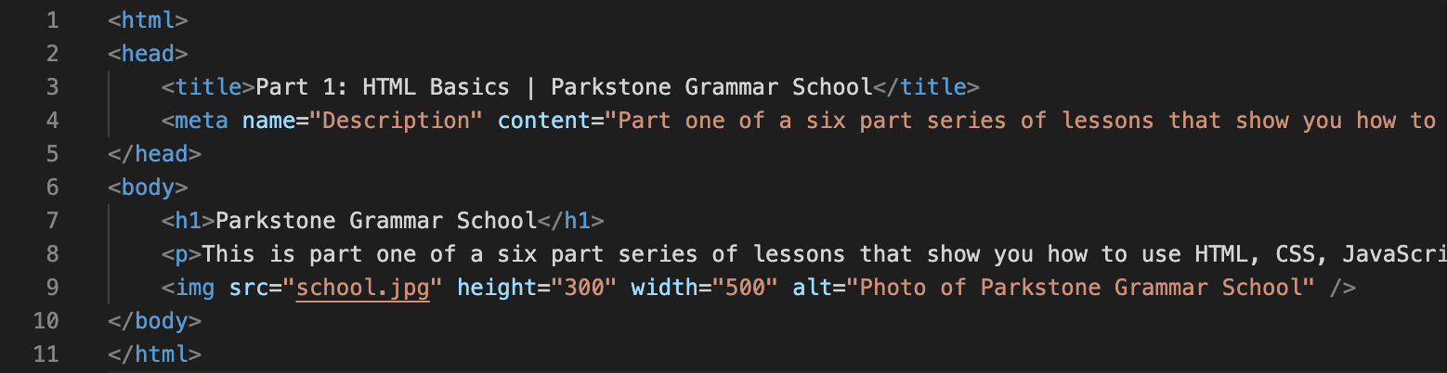
Activity 1 - Review

Slide 10
End of section questions
What are the functions of the following HTML tags?
<html>
<head>
<body>
<p>

Slide 11
What is CSS?
Cascading Style Sheets (CSS) are used to alter the appearance everything
Tags on a page can share (inherit) their appearance
Tags can also have a unique appearance if necessary
Tags can be styled in three ways: Inline, Internal, External
CSS saves a lot of work!

Slide 12
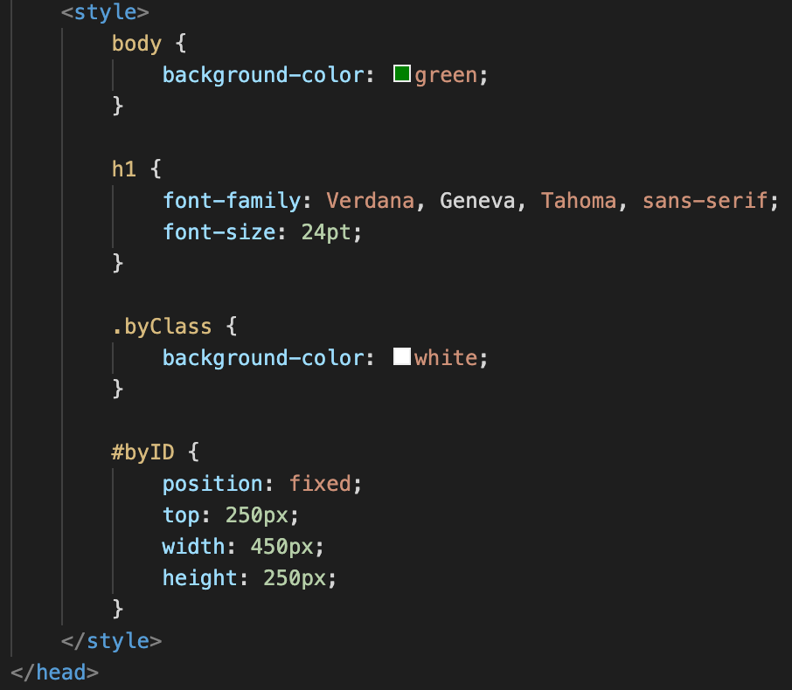
Internal CSS
Contained within <style></style>
Rule consists of a selector and a declaration contained within {}
Selectors are used to find the HTML elements you want to style by element, class or id
Value
Property

Slide 13
Additional HTML tags
Important HTML attributes
<div> | Defines separate areas in a page that can be named and styled differently using CSS.
class | The HTML class attribute is used to specify a class for an HTML element. Multiple HTML elements can share the same class.
id | The HTML id attribute is used to specify a unique id for an HTML element.

Slide 14
Important CSS Declarations
background-color | Colours are specified using 140 predefined names or RGB values in hex. https://www.w3schools.com/colors/colors_hex.asp
font-family | Use the font-family property to specify the font of a text including a fallback option. Eg. Verdana, Arial, sans-serif;
font-size | The font-size property sets the size of the text in either pixels (20px) or points (16pt).
position | The position property specifies the type of positioning method used for the element. Eg. static, relative, fixed, absolute.
float | The float property is used for positioning and formatting content Eg. An image floating on the left of text within a div element.
top, left | top & left properties are used to set the edge of the element.
width, height | height & width properties are used to set the size of an element.

Slide 15
Activity 2
20 minutes
Add the following to your page:
Set the background colour
Position your title, paragraph(s) and photo on the right
Add the road to the scene
Add the zebra crossing to the road
Insert your HTML code into Microsoft Teams

Slide 16
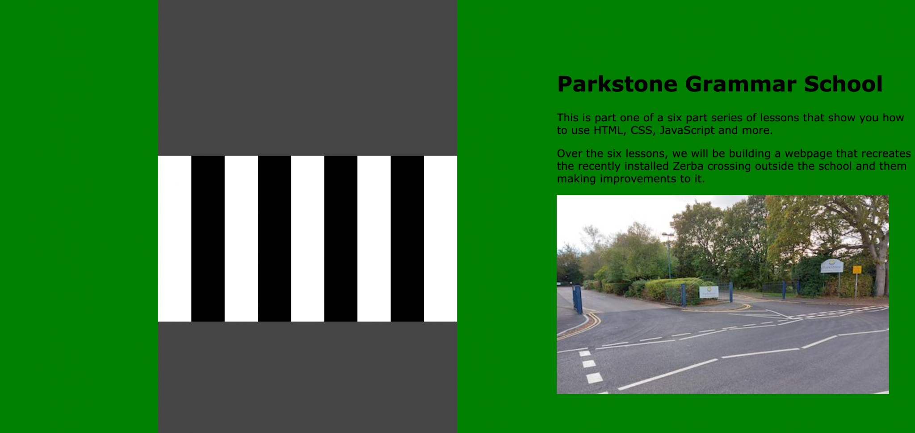
Activity 2 - Review

Slide 17
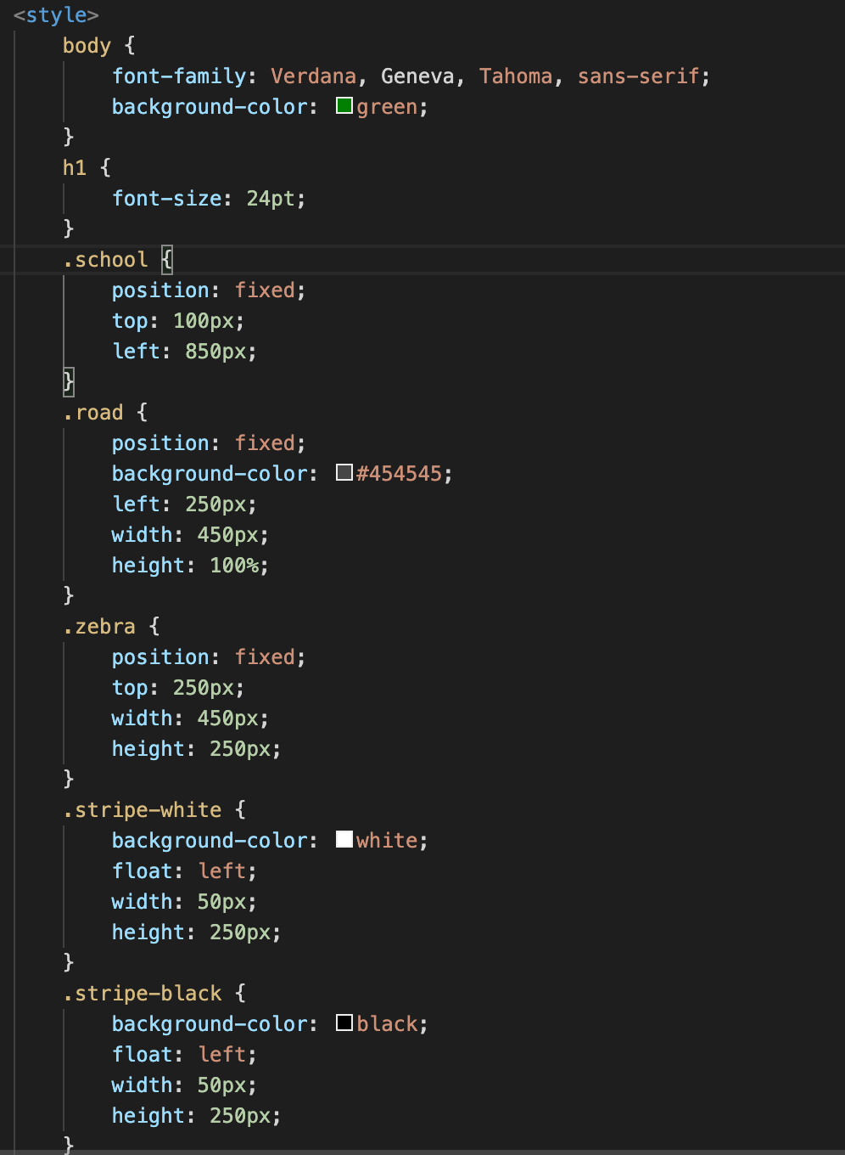
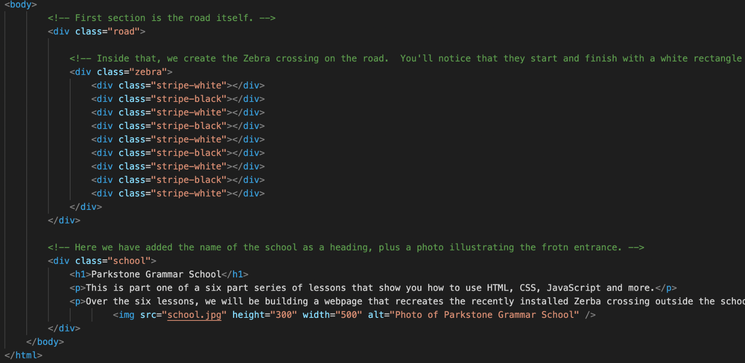
Activity 2 - Review

Slide 18
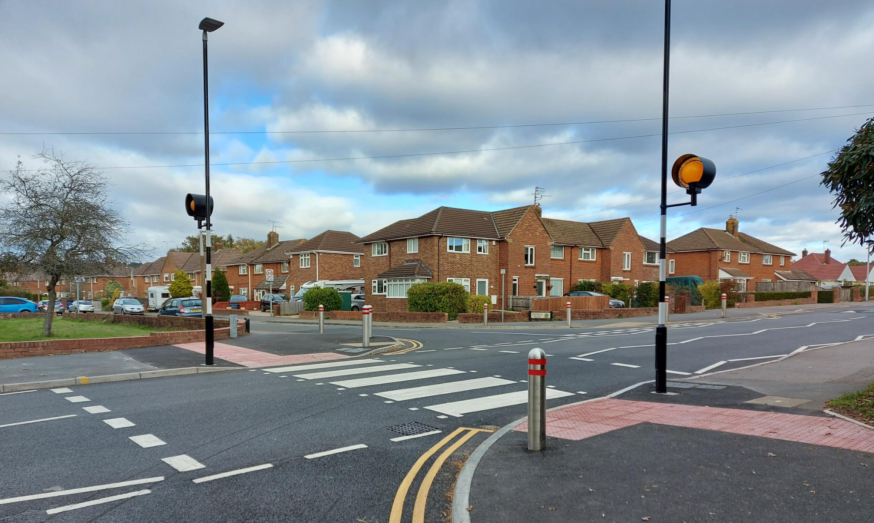
Next Lesson - Adding Dynamic Styling using CSS

